Slide 1
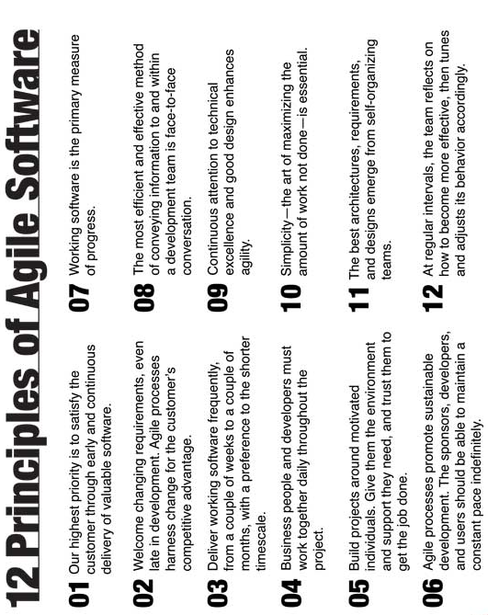
Agile Manifesto
We are uncovering better ways of developing software by doing it and helping others do it. Through this work we have come to value:
Individuals and interactions over processes and tools
Working software over comprehensive documentation
Customer collaboration over contract negotiation
Responding to change over following a plan
That is, while there is value in the items on the right, we value the items on the left more.

Slide 2
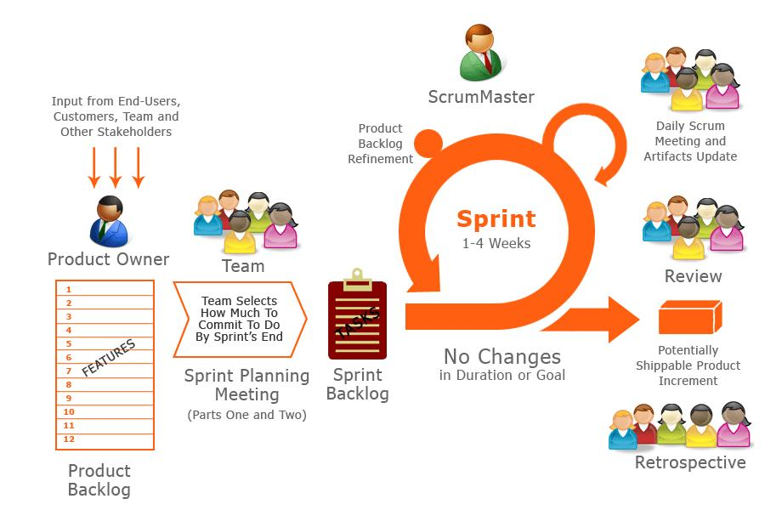
agile.office@monsanto.com

